Slide 1
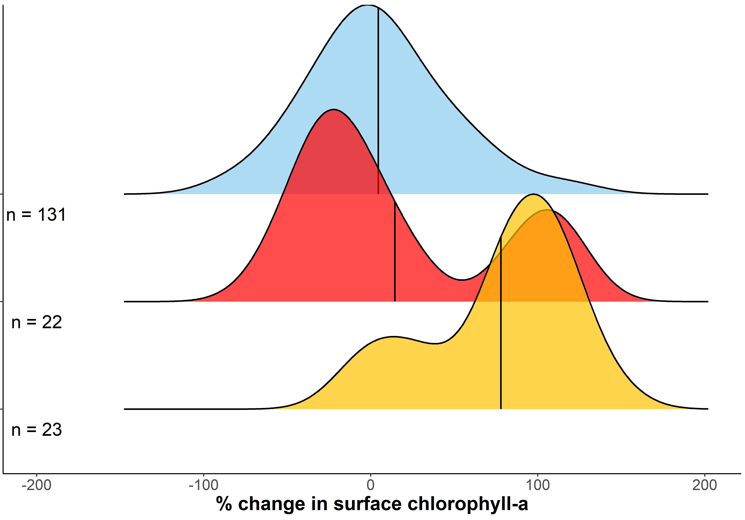
Mean = 4% increase
Mean = 14% increase
All other days
During heatwave
Mean = 78% increase
After heatwave
Notes:
Tuesday

Slide 2
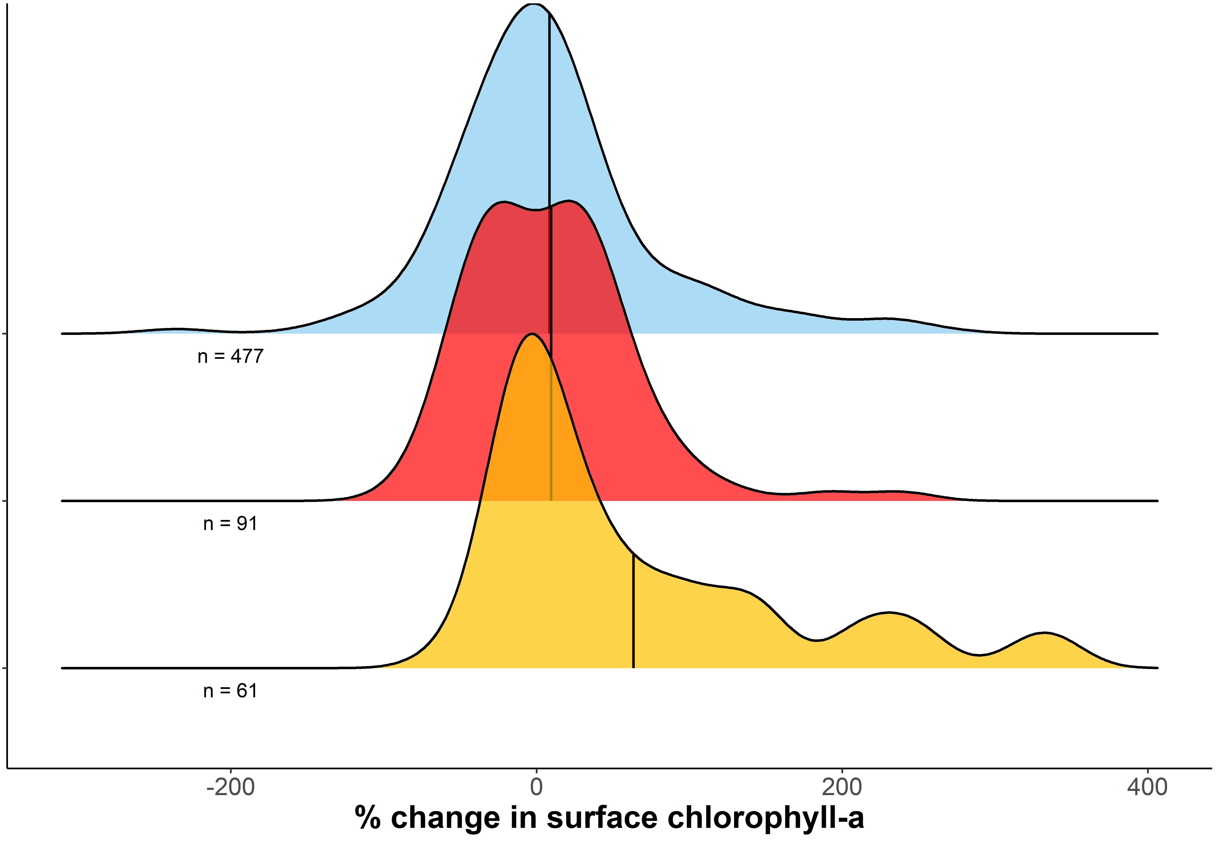
Mean = 8% increase
Mean = 9% increase
All other days
During heatwave
Mean = 63% increase
After heatwave
Notes:
Peter

Slide 3
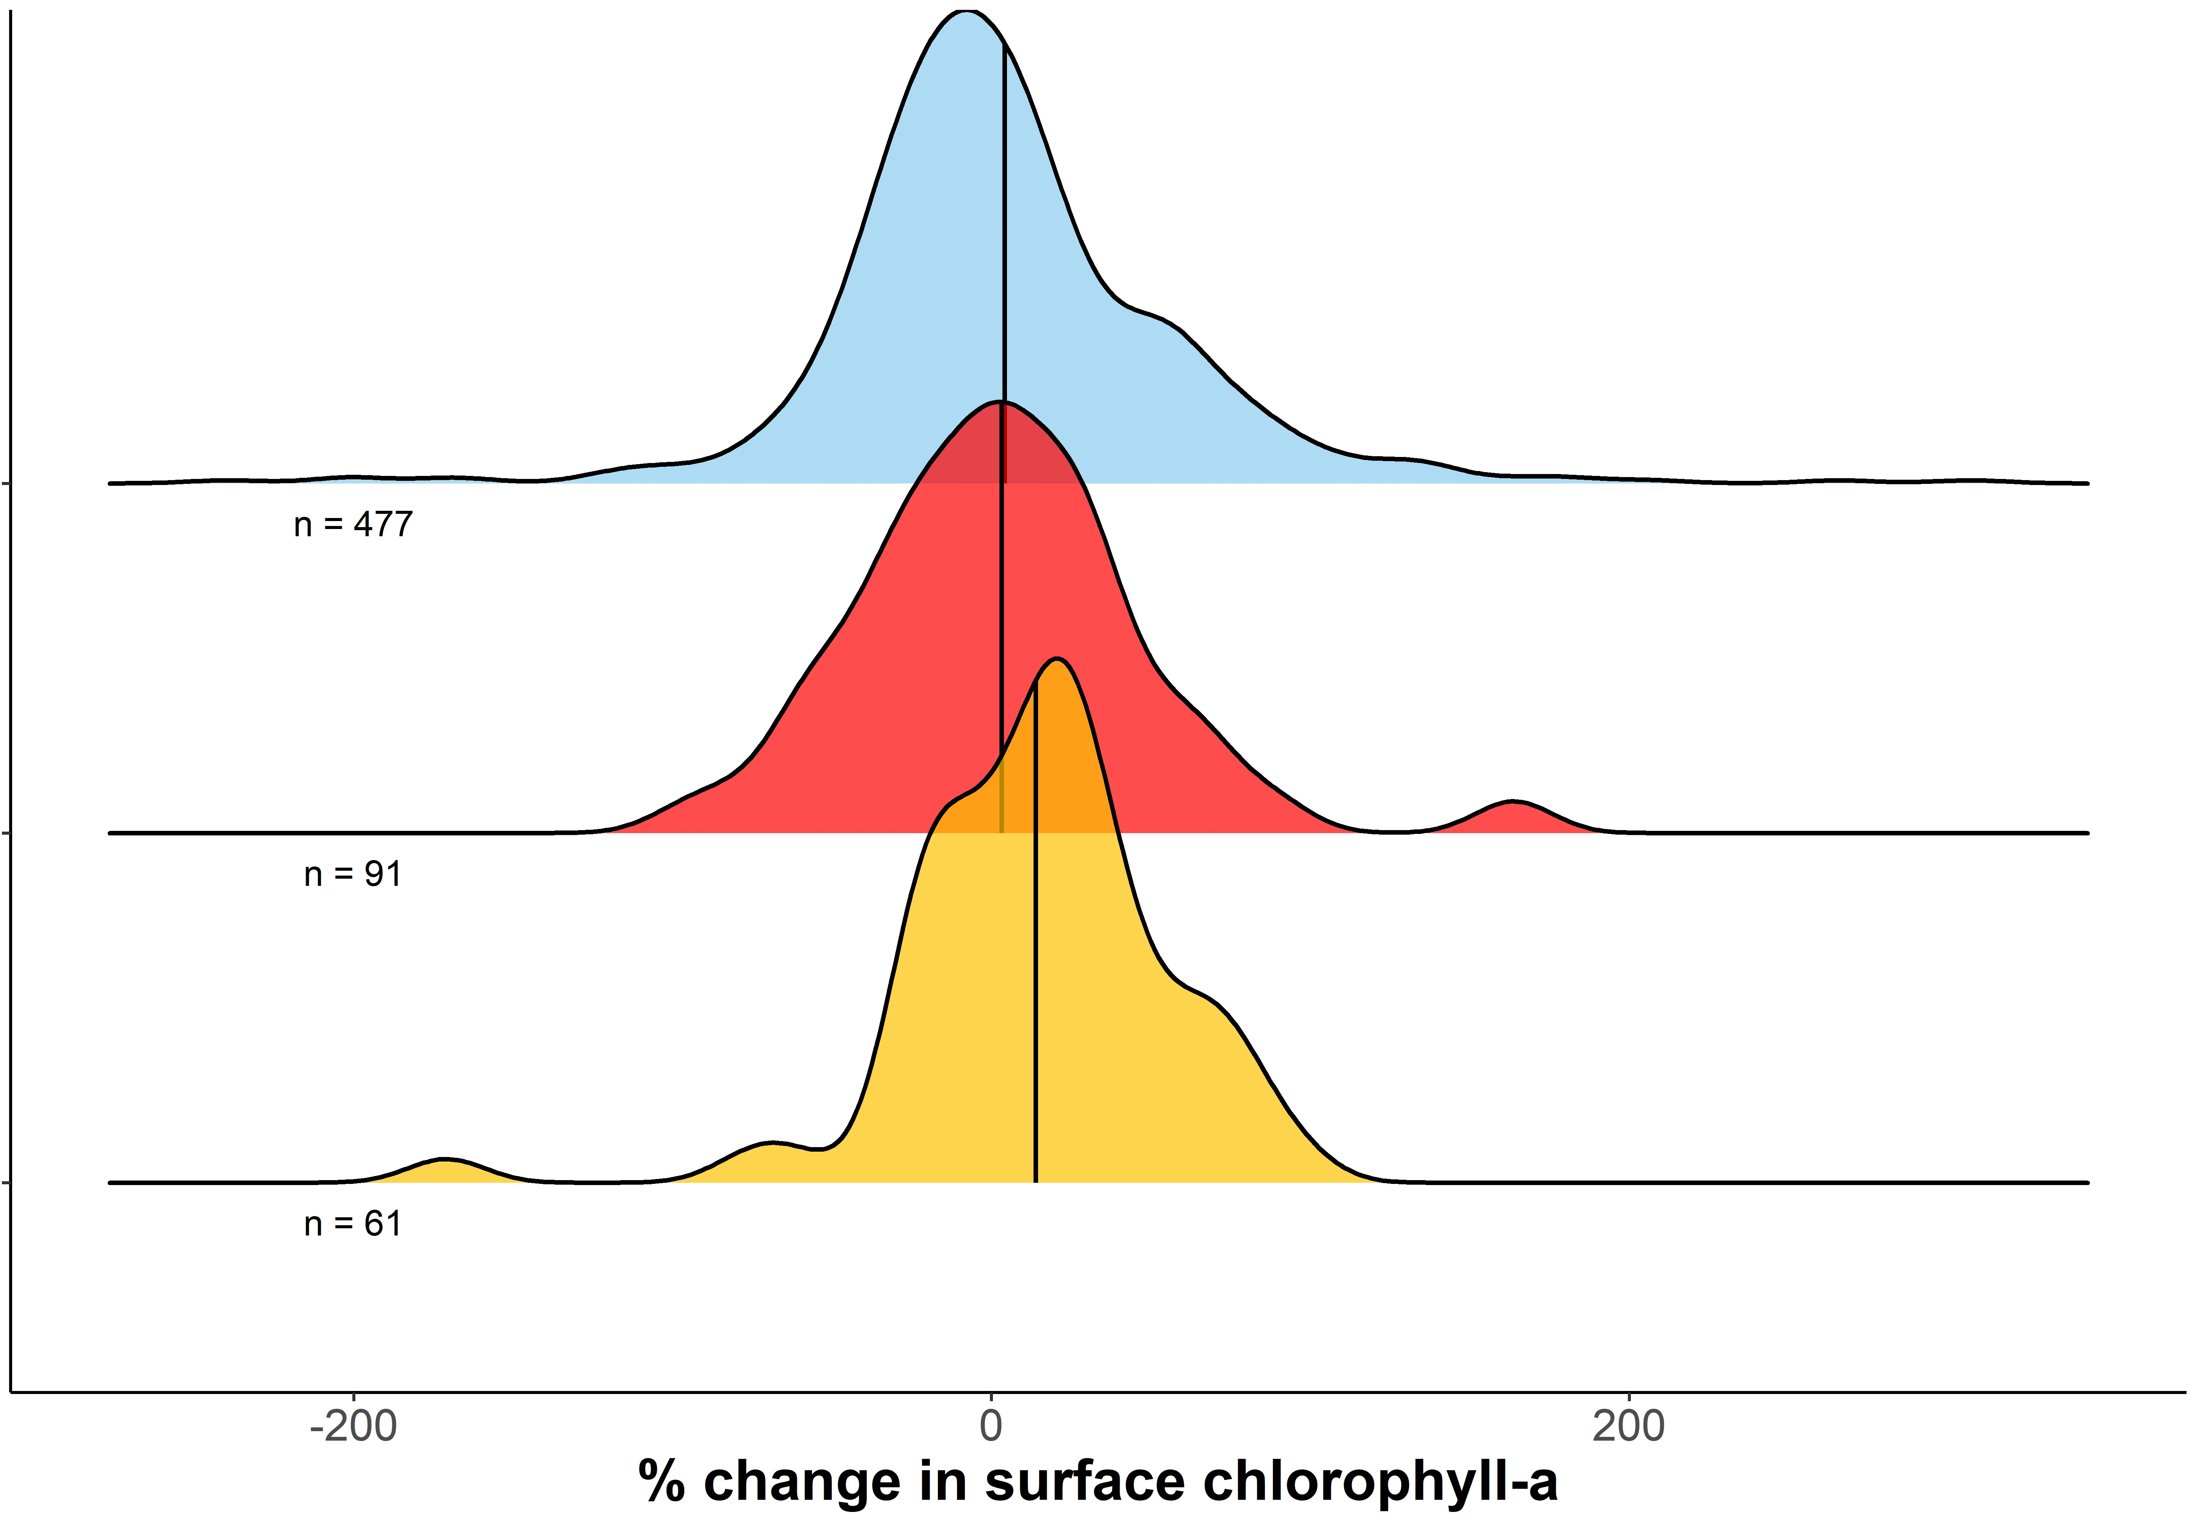
Mean = 4% increase
All other days
Mean = 3% increase
During heatwave
Mean = 14% increase
After heatwave
Notes:
Paul

